Slide 1

Fitting an unknown function
System Identification 2023-2024
Szakacs Armand-Antonio
Petcuț Adrian-Axente
Ilea Cosmin-Ionuț
Group Id: 25

Slide 2
Table of contents :
Problem statement
Polynomial Approximator
Key features
Tuning Results
Plots for the optimal value
Conclusions

Slide 3
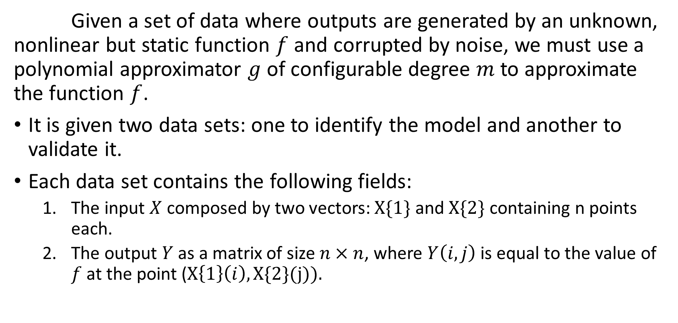
Problem statement
Given a set of data where outputs are generated by an unknown, nonlinear but static function $f$ and corrupted by noise, we must use a polynomial approximator $g$ of configurable degree $m$ to approximate the function $f$.
It is given two data sets: one to identify the model and another to validate it.
Each data set contains the following fields:
  The input $X$ composed by two vectors: $X\{1\}$ and $X\{2\}$ containing n points each.
  The output $Y$ as a matrix of size $n×n$, where $Y\left(i,j\right)$ is equal to the value of $f$ at the point ($X\left\{1\right\}\left(i\right),X\{2\}(j)).$

Slide 4
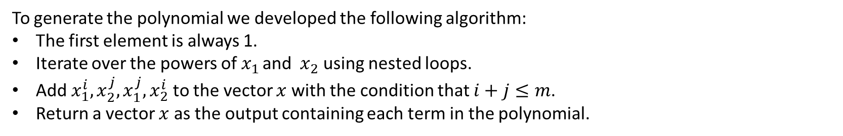

Polynomial Approximator
We were given a polynomial of approximator with a configurable degree m of the following form:
$m=1,\hat{g}\left(x\right)=\left[1,x_{1},x_{2}\right]∙θ$
$m=2,\hat{g}\left(x\right)=\left[1,x_{1},x_{2},x_{1}^{2},x_{2}^{2},x_{1}x_{2} \right]∙θ$
$m=3,\hat{g}\left(x\right)=\left[1,x_{1},x_{2},x_{1}^{2},x_{2}^{2},x_{1}^{3},x_{2}^{3},x_{1}x_{2},x_{1}^{2}x_{2},{x_{1}x}_{2}^{2}\right]∙θ$
To generate the polynomial we developed the following algorithm:
The first element is always 1.
Iterate over the powers of $x_{1 }$and ${ x}_{2}$ using nested loops.
Add $x_{1}^{i},x_{2}^{j},x_{1}^{j},x_{2}^{i}$ to the vector $x$ with the condition that $i+j≤m$.
Return a vector $x$ as the output containing each term in the polynomial.

Slide 5

Key features
Easy to read code
Graphs for every type of identification and validation
The algorithm works for any dataset given without additional user input
We transform the matrix into a collum vector for easier computation and understanding of the code
We automated the process of choosing the best $m$ based on the lowest Mean Square Error

Slide 6
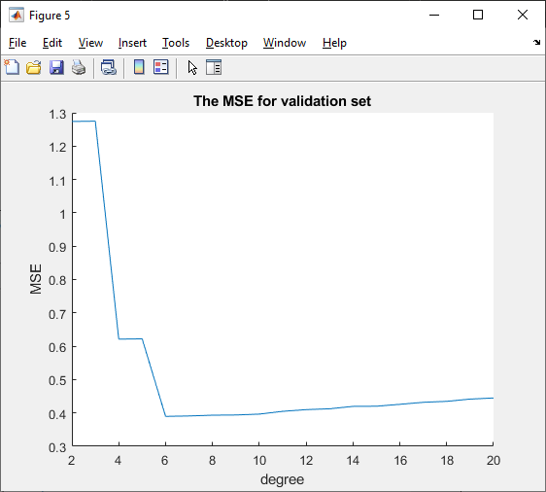
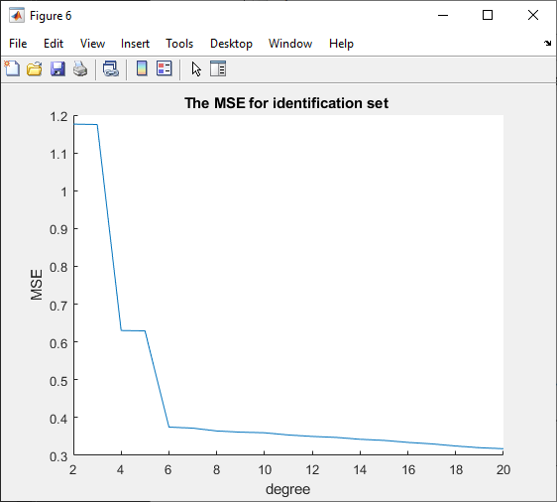
Tuning Results
To avoid overfitting we choose 6 as the optimal value for m.

Slide 7
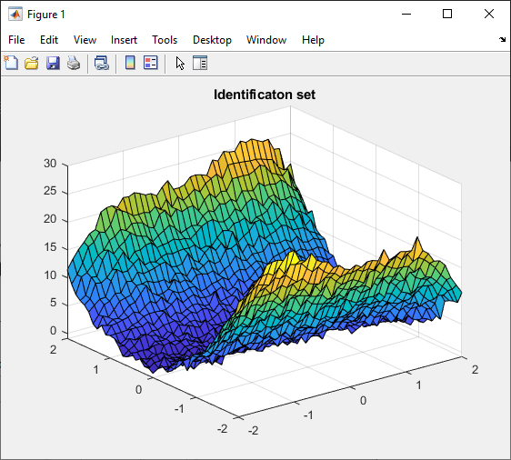
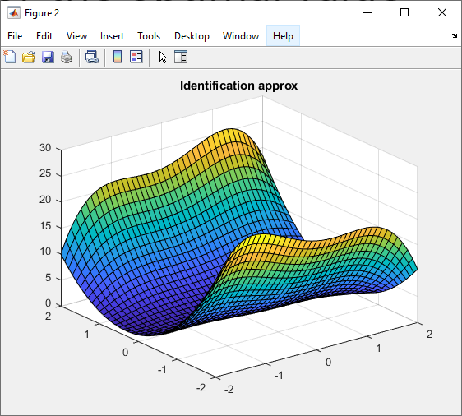
Plots for the optimal value (m=6)
MSE=0.37

Slide 8


MSE=0.38

Slide 9

Conclusions
Linear regression is a very strong and simple to understand method for identifying models
$m$ can be adjusted to get an optimal model
We developed a strong solution to the problem

Slide 10
Appendix
for degree=2:20
%COMPUTE THETA
phi = compPhi(id.X, degree);
theta = phi \ newY_id;
%approximation for identification set
approxId = phi*theta;
%approximation for validation set
phi = compPhi(val.X, degree);
approxVal = phi*theta;
%compute MSEs for both sets
MSE_id = compMSE(approxId, newY_id);
MSE_val = compMSE(approxVal, newY_val);
MSE_v = [MSE_v MSE_val];
MSE_i = [MSE_i MSE_id];
%finding the degree with the minimum mse
if MSE_val < MSE_previous
MSE_previous = MSE_val;
degree_min = degree;
end
end
%MSE vectors
MSE_v = [];
MSE_i = [];
%variables we use to find the degree for minium MSE
MSE_previous = 100;
degree_min = 0;
%from output matrix to collumn vector
newY_id = matToVec(id.Y);
newY_val = matToVec(val.Y);

Slide 11
f4 = figure;
movegui(f4, 'south');
surf(id.X{1}, id.X{2}, approxIdMat);
title("Identification approx")
f5 = figure;
movegui(f5, 'northeast');
surf(val.X{1}, val.X{2}, val.Y);
title("Validation set")
f6 = figure;
movegui(f6, 'southeast');
surf(val.X{1}, val.X{2}, approxValMat);
title("Validation approx")
%plot the MSE for both sets;
f1 = figure;
hold on;
movegui(f1, 'northwest');
plot(2:20, MSE_v);
xlabel('degree');
ylabel('MSE');
title("The MSE for validation set");
hold off;
%plot the MSE;
f2 = figure;
hold on;
movegui(f2, 'southwest');
plot(2:20, MSE_i);
xlabel('degree');
ylabel('MSE');
title("The MSE for identification set");
hold off;
degree = degree_min;
%COMPUTE THETA
phi = compPhi(id.X, degree);
theta = phi \ newY_id;
%approximation for identification set
approxId = phi*theta;
%approximation for validation set
phi = compPhi(val.X, degree);
approxVal = phi*theta;
%approximation from vector to matrix
approxIdMat = vecToMat(approxId, id.dims(1));
approxValMat = vecToMat(approxVal, val.dims(1));
%plot the approximation vs real values
f3 = figure;
movegui(f3, 'north');
surf(id.X{1}, id.X{2}, id.Y);
title("Identificaton set")

Slide 12
Polynomial approximator generator
Functions:
Creating MSE
function [x] = polygen(polydegree, x1, x2)
i = 1;
x = [1];
while i < polydegree
j = 0;
while j <= i && i+j <= polydegree
x = [x x1.^i .* x2.^j];
if i ~= j
x = [x x1.^j .* x2.^i];
end
j = j + 1;
end
i = i + 1;
end
j = 0;
x = [x x1.^i .* x2.^j];
x = [x x1.^j .* x2.^i];
end
function [MSE] = compMSE(approx, trueVal)
MSE = 0;
for i=1:length(approx)
MSE = MSE + (approx(i) - trueVal(i))^2;
end
MSE = MSE / length(approx);
end

Slide 13
Creating Phi
Matrix to vector
Vector to matrix
function [phi] = compPhi(cellArray, degree)
phi = [];
for i = 1:length(cellArray{1})
for j = 1:length(cellArray{2})
phi = [phi; polygen(degree, cellArray{1}(i), cellArray{2}(j))];
end
end
end
function [vec] = matToVec(matrix)
vec = [];
for i = 1:length(matrix)
vec = [vec matrix(i,:)];
end
vec = vec';
end
function [matrix] = vecToMat(vector, dimension)
matrix = [];
for i = 1:length(vector)
if mod(i, dimension) == 0
matrix = [matrix; vector(i-dimension+1:i)'];
end
end

